Slide 1
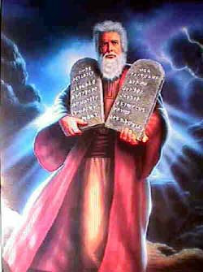
The First Command-ment
http://tracksuitceo.files.wordpress.com/2007/07/10-commandments-of-supporting-your-family.jpg

Slide 2
First Commandment
You shall have no other Gods
Exodus 20:3

Slide 3
Another common way you hear it:
Thou shalt have no other gods before me

Slide 4

What does it mean to “have a God”
It means to:
trust God the most
Belong to God
obey God above others
love God above other things

Slide 5
God said to Abraham,
“I will be God to you, and to your descendants after you.”
We are part of God’s people and so God promises this to us.

Slide 6
Martin Luther’s comment:
He says that “having no other gods” would mean:
To fear, love, and trust in God above all else.

Slide 7
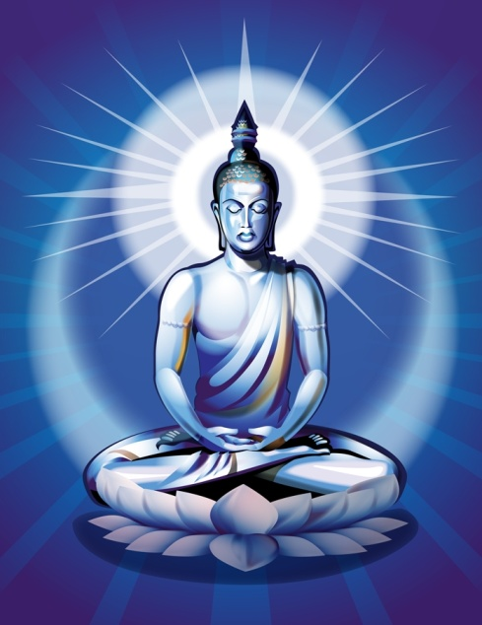
Another Way to Say it :
Whatever you fear, love, or trust above all other things --- Is your God.
If it is not the true God, Then it is an idol.

Slide 8
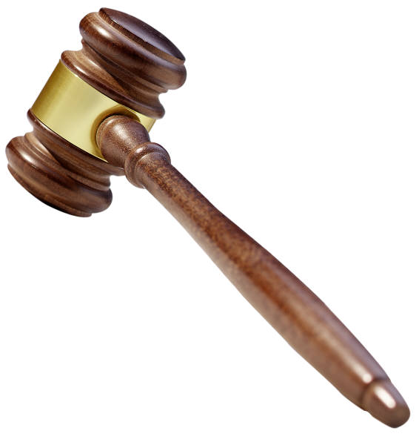
Why does he say “fear and love?”
The “fear part” reminds us that God is in charge, and when we see that we have let something get above God in our lives, we see our sin more clearly.

Slide 9
The “love” part …
shows us that putting God first is a way to express our love for God.
But we can’t see God!
So …

Slide 10
Jesus is the God made visible :
“No one has seen God at any time, but the only Son, who is the same as God, and at the Father’s side, he has made God known.” (John 1:18)

Slide 11
The qualities of Jesus …
show us the qualities of God.
Through what Jesus did, he showed what God is like, and that the heart of God is love.

Slide 12
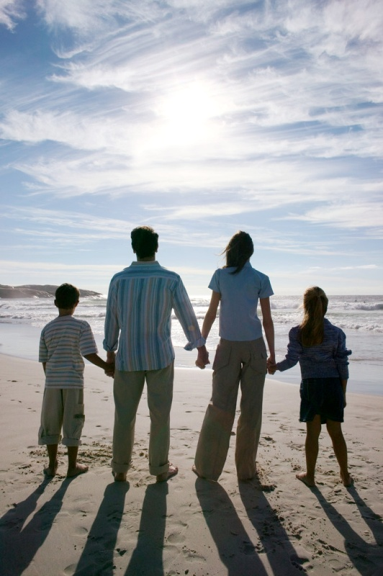
When you trust Jesus …
you automatically are in God’s family, and so “God is your God.”
Jesus said, “No one comes to the father except by me.” (John 14:6)

Slide 13

Another Key verse :
The LORD Almighty has this to say: I am the first, the last, the only God, there is no other god but me.
Isaiah 44:6

Slide 14
But …
other things want to be our god --- they want to be first in our life, above God.

Slide 15
If you don’t trust in God
then that automatically means you are trusting something else, because you have to trust in something

Slide 16

If someone says …
“I don’t want to worship God --- I want to worship a carved stone (idol).”
then what is their god?

Slide 17
If someone says,
“I don’t want to obey God --- I’ll do whatever I feel like”
then what is their god?

Slide 18
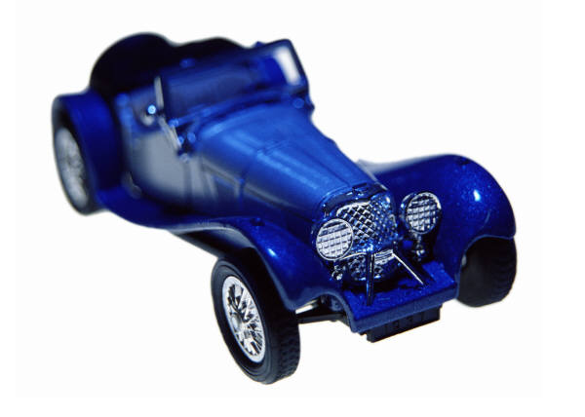
What are other common idols
in our world today?
(What do people like to put first, ahead of God)
(When there is a conflict
between God’s will and
the person’s will, then you
will find out which one
that person puts first)

Slide 19
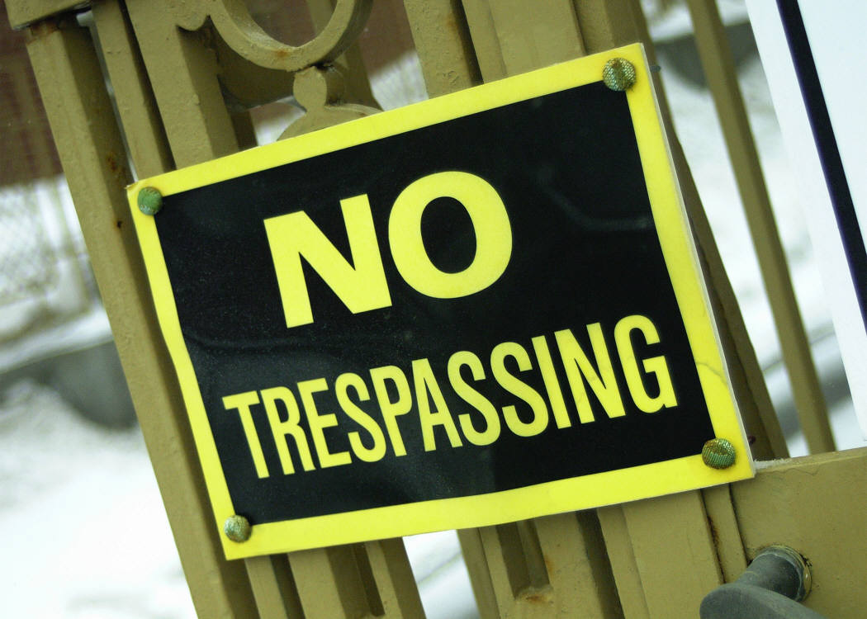
The problem is ---
can these other gods actually DO what God can do?

Slide 20
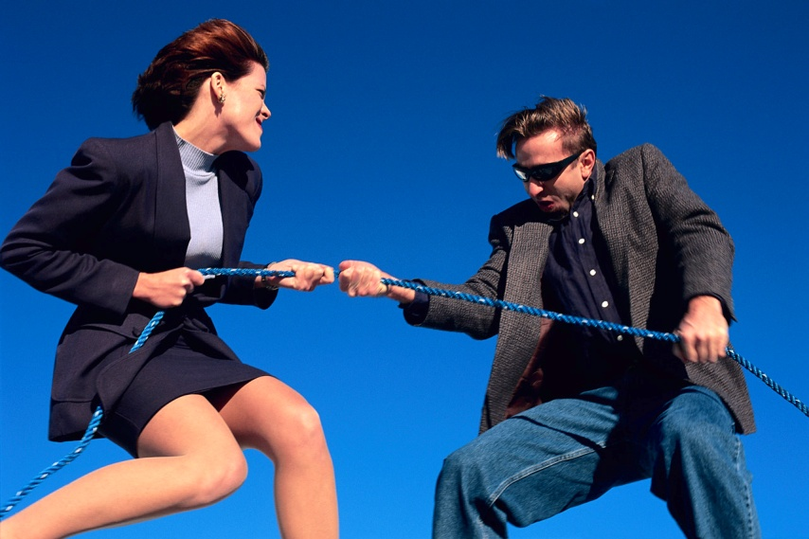
The Battle is On
We Christians all have a new nature that like to obey God., but we still have an old nature that likes to worship other gods. When we look to anything else except God for those things that we should be looking to God for, AHA, we have caught our old nature in action. We have caught it breaking the first commandment. As soon as we realize this, we say, “I’m sorry, God, please forgive me and change me,”

Slide 21
Showing that God is in first place.
How much you respect God is shown by How much you respect God’s representatives – the ones God has placed over you. Parents; Teachers; government.

Slide 22
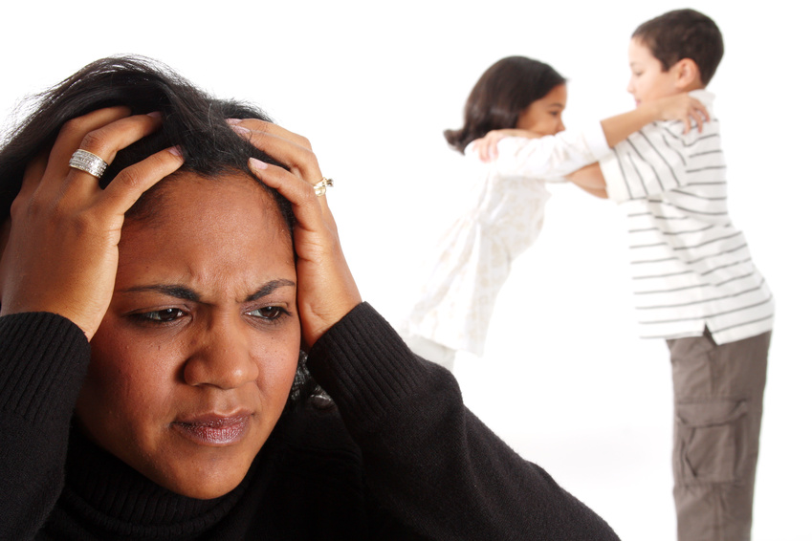
Visible proves Invisible:
“The one who does not love his brother, Whom he HAS seen, cannot love God, whom he has not seen.” 1 John 4:20

Slide 23
To say it another way:
When we obey the people that God has placed over us, that shows that we are obeying God, even though we cannot see him. Respect for those God has put over us Is a way to show our respect for God.

Slide 24
The Bible says,
Keep Safe, My children, keep yourselves safe from idols. 1 John 5:21
End of command one. Go on for more info:

Slide 25
Why would God give us commands? (1)
It’s NOT to make our lives miserable ----
In fact, keeping the commands would lead to a happy life.

Slide 26
Why would God give us commands? (2)
It’s NOT so we can deserve God’s love ----
In fact, God loves us already.

Slide 27
Why would God give us commands? (3)
It’s NOT so we can think we are better than others ----
In fact, the commands show us that all of us have disobeyed God ----
So the commands move us to rely on Jesus to forgive us, and that strengthens our faith.

Slide 28
The end
Written by Jim Found
Design by Lizzy O.
Copyright notice: pictures from Microsoft Word Clip Art files.

